Slide 1

Team 6 Decreasing Injury Severity in car Crashes

Slide 2
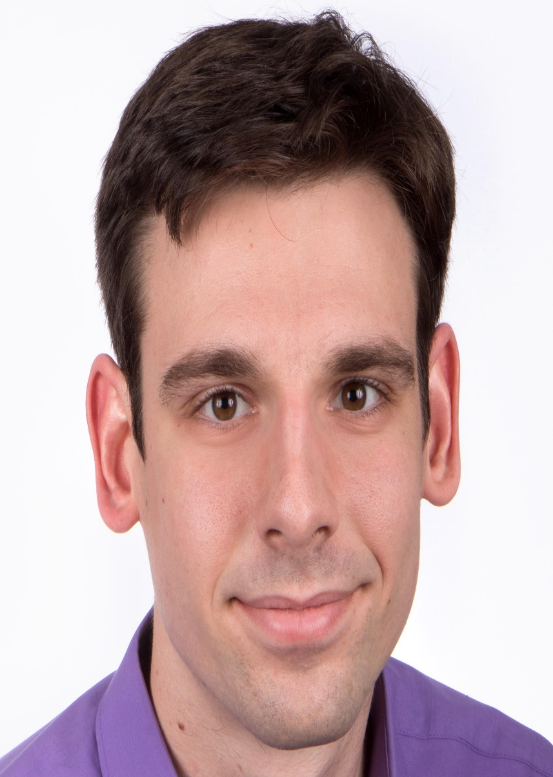
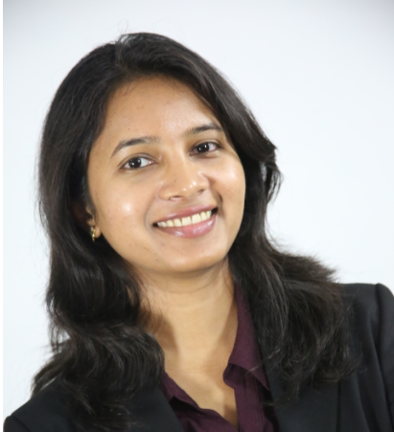

Team Members
Jacob Slayter
Ramya K Vannappa
Asad Rahman

Slide 3
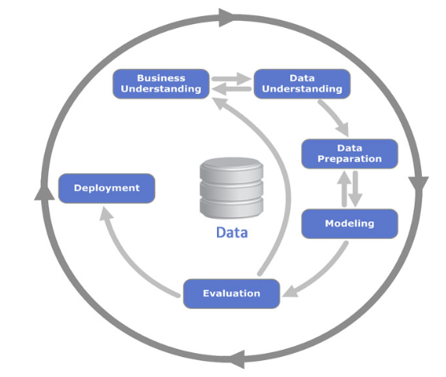
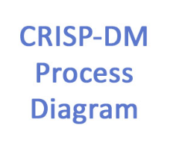

Slide 4

Business Understanding
Used the two papers from the professor
Our own understanding.
Notes:
For our business understanding we kept it simple and used the supplemental reading the professor provided and our understanding of car crashes. We did not do very much research into it outside of that. As to help keep our opinions from becoming bias

Slide 5

Data Understanding
Used Crash Report Sampling System (CRSS) Manual.
This Photo by Unknown Author is licensed under CC BY-SA
Notes:
We used the user manual supplied with the data to help us better understand the data and what each number in the data stood for.

Slide 6
Data Preparation

Slide 7
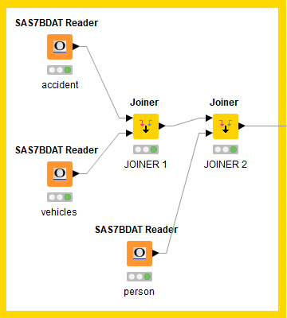
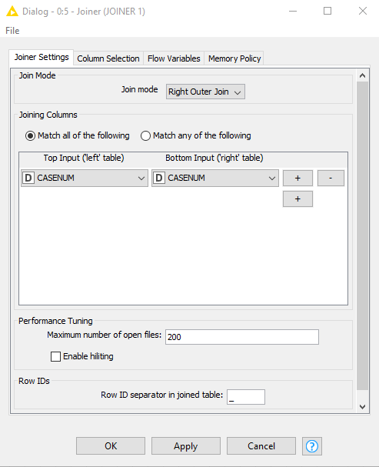
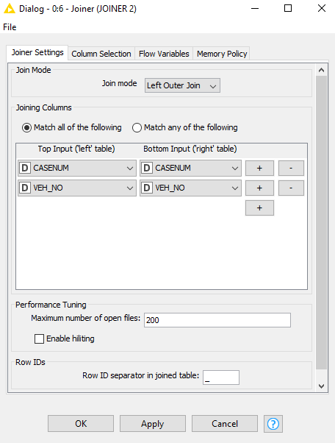
JOINING THE DATASETS
Joiner1 -- right outer using “CASENUM”
Joiner2- left outer using “CASENUM” and “VEH_NO”

Slide 8
AFTER 2 JOINS
133,608
ROWS
196 COLUMNS

Slide 9
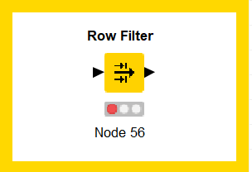
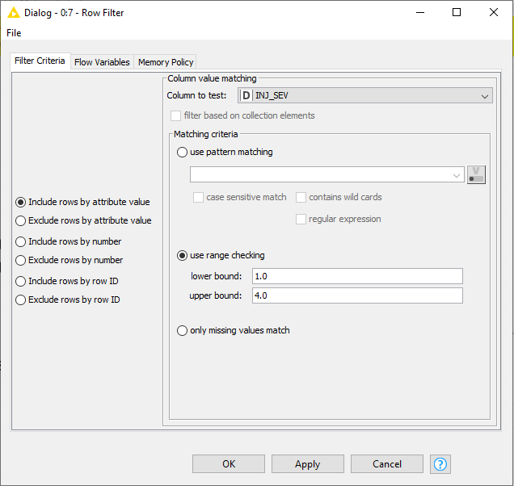
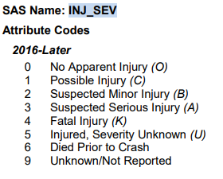
ROW FILTER
To remove UNWANTED and UNKNOWN values from our target variable “INJ_SEV” by setting the lower and upper bound - 1 & 4.

Slide 10
AFTER ROW FILTER
36,956
ROWS
196 COLUMNS

Slide 11
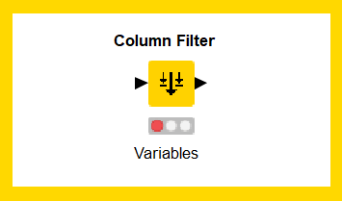
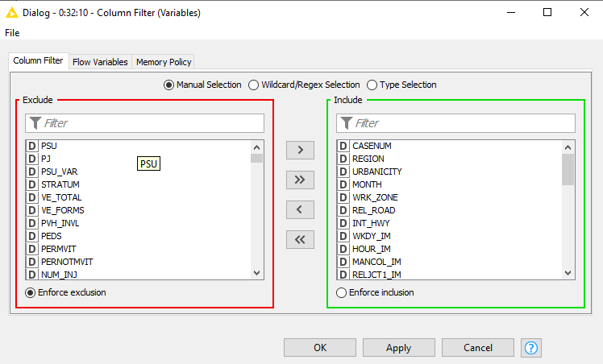
COLUMN FILTER
Based on domain expertise
Based on research papers

Slide 12
AFTER COLUMN FILTER
36,956
ROWS
38 COLUMNS

Slide 13
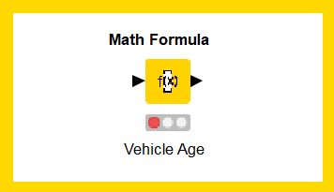
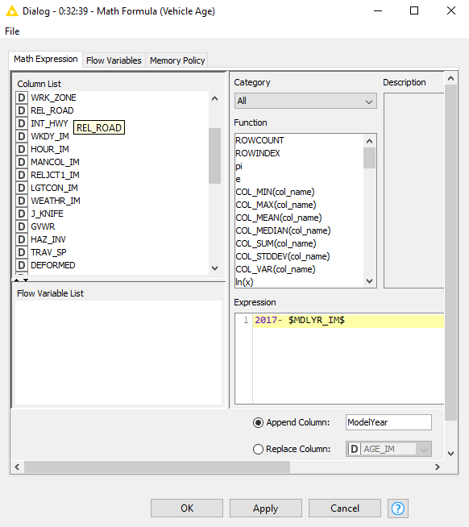
MATH FORMULA (VehicleAge)
Created new column called “ModelYear”.
Determined Vehicles Age
FORMULA:
2017- $MDLYR_IM$

Slide 14
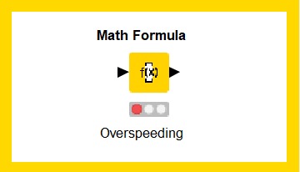
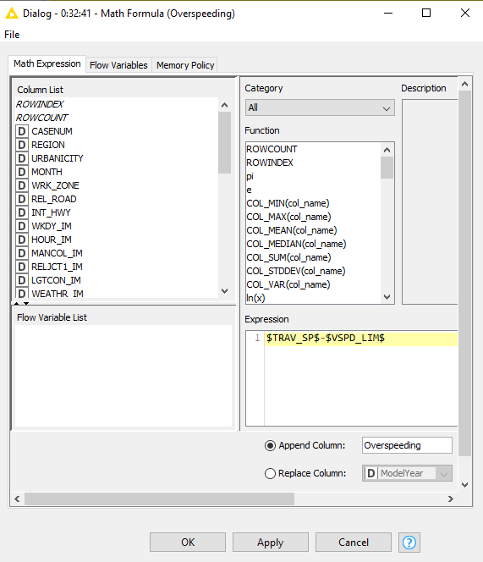
MATH FORMULA (Overspeeding)
Created new column called “Overspeeding”.
Determined whether the vehicle is overspeeding or not.
FORMULA:
$TRAV_SP$-$VSPD_LIM$

Slide 15
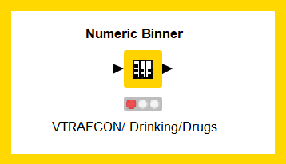
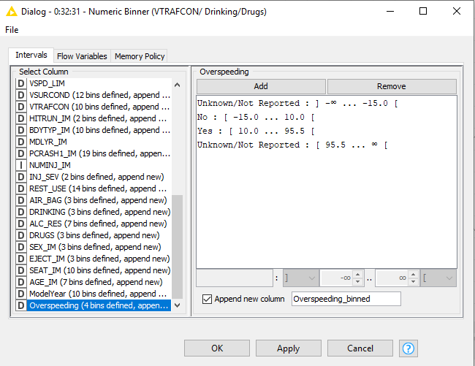
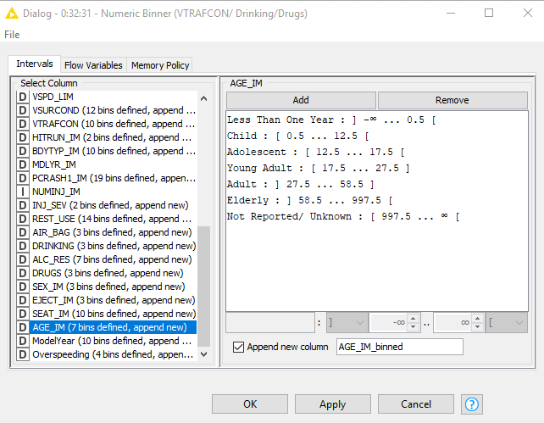
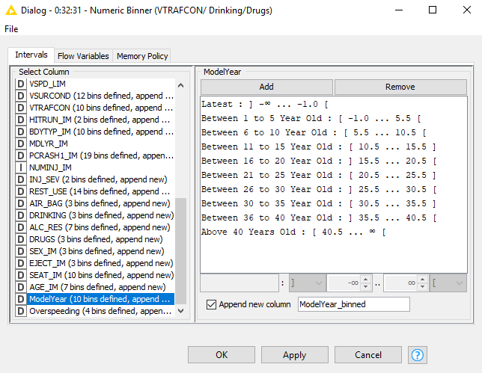
NUMERIC BINNER
KEPT ALL THE UNKNOWN/NOT REPORTED VALUES IN SEPARATE BIN FOR EACH COLUMN.

Slide 16
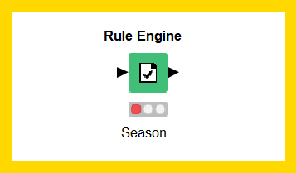
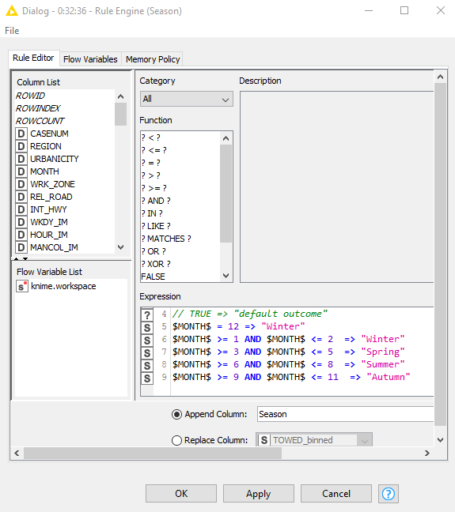
Rule Engine (Season)
Using Month column, we created a column called “Season”.
Created four seasons.

Slide 17
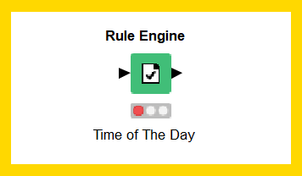
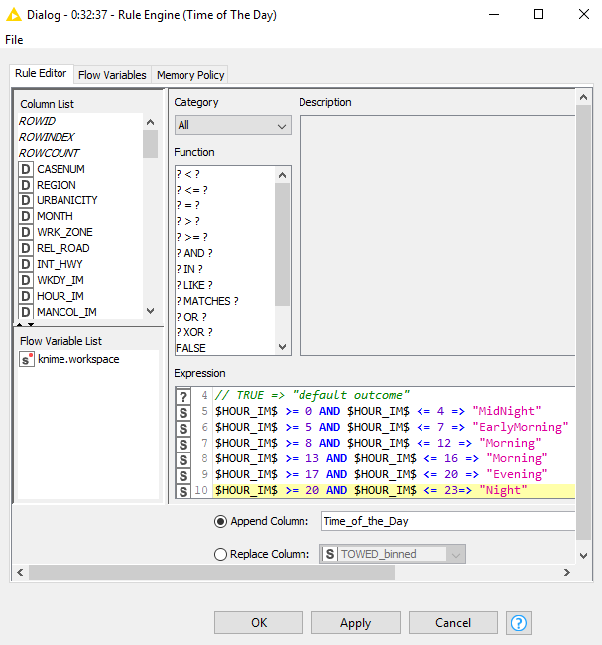
Rule Engine (Time of The Day)
Using Hour_IM column, we created a column called “Time of the Day”.
Created five Time of the Day.

Slide 18
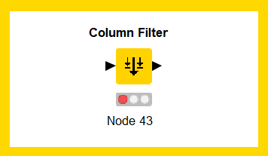
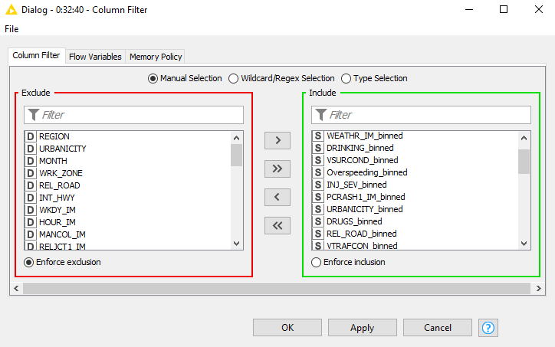
COLUMN FILTER

Slide 19
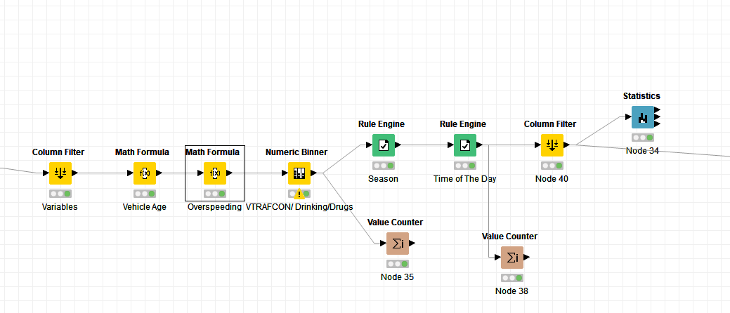
Data - Preprocessing

Slide 20
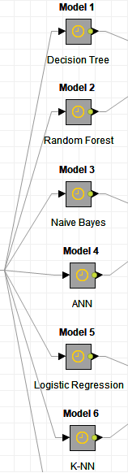
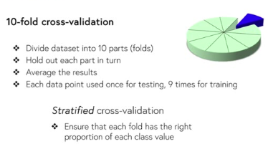
Modeling
Decision Tree
Random Forest
Naïve Bayes
ANN
Logistic Regression
KNN

Slide 21
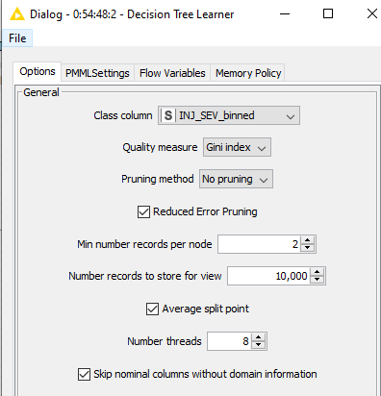
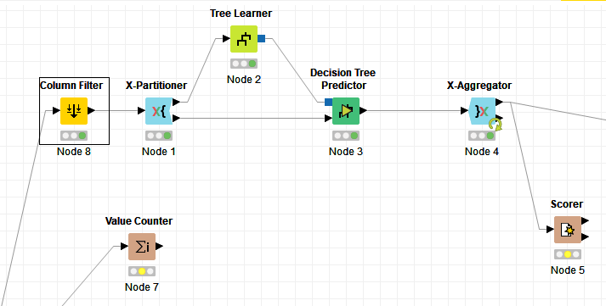
Decision Tree

Slide 22
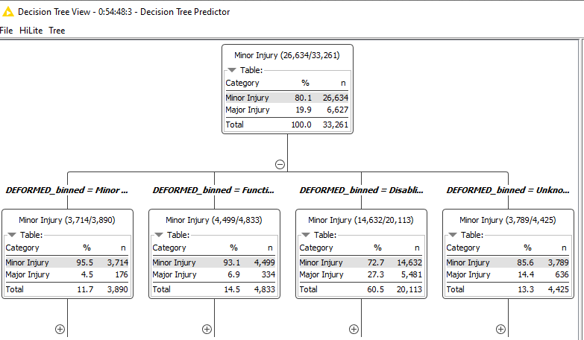
Decision Tree View

Slide 23
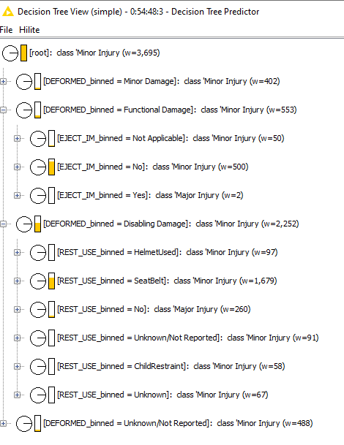
Important Predictors – Decision Tree

Slide 24
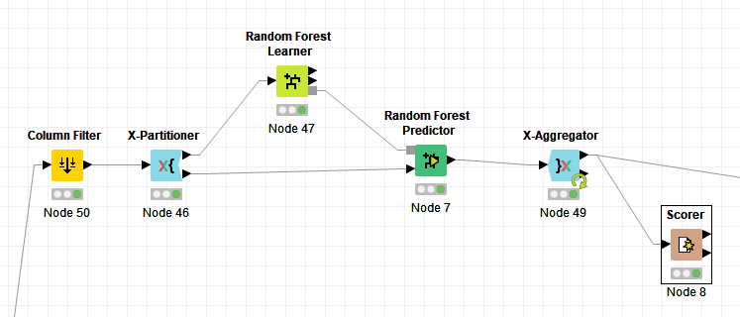
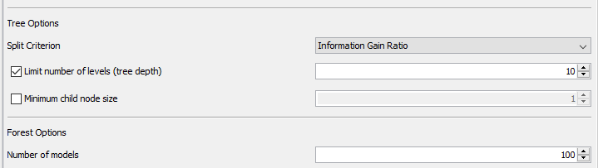
Random Forest

Slide 25
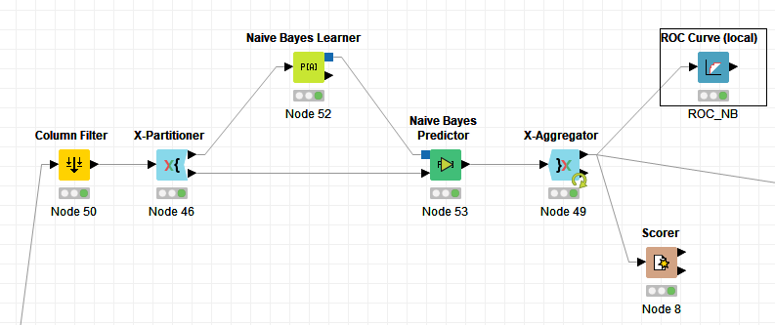
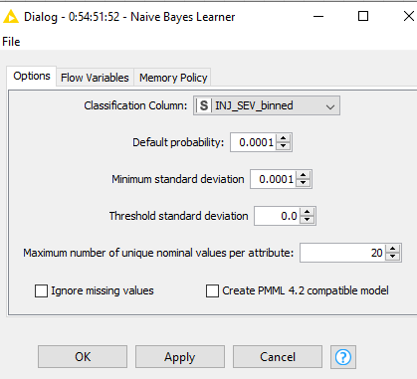
Naïve Bayes

Slide 26
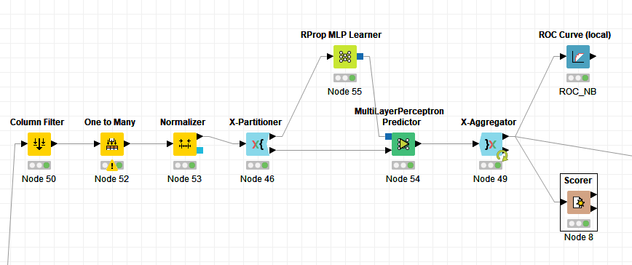
Multilayer Perceptron (class of feedforward ANN)

Slide 27
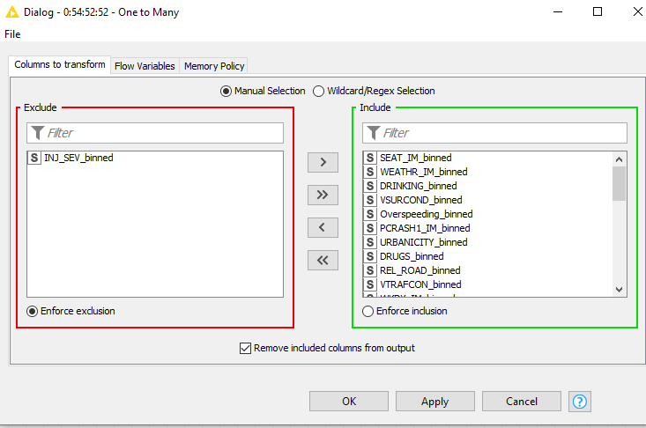
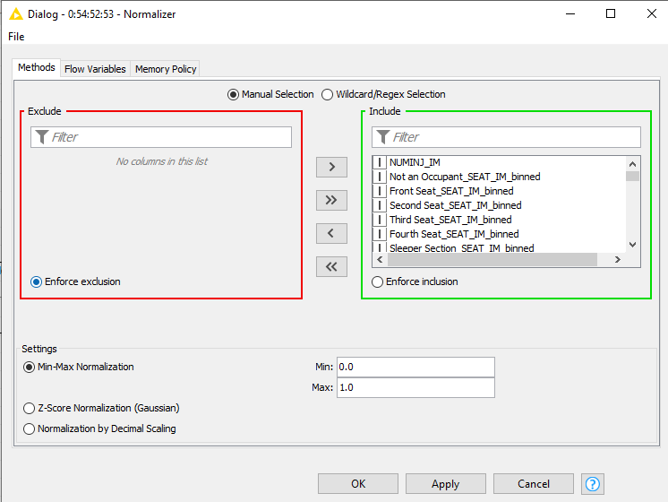
One-to-Many and Normalizer
transforms x to y= (x-min)/(max-min),

Slide 28
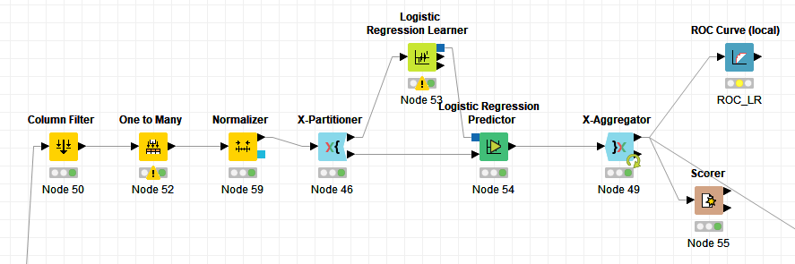
Logistic Regression

Slide 29
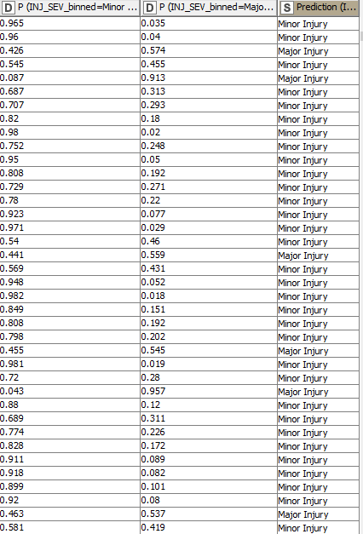
Predicted data - Logistic Regression

Slide 30
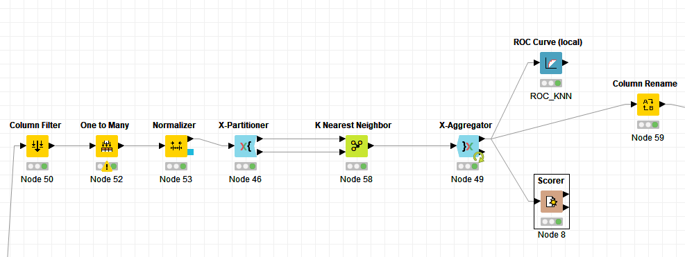
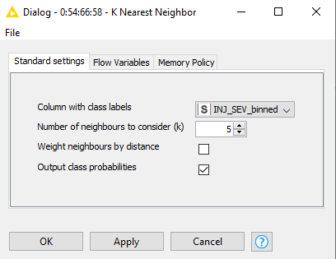
K-Nearest Neighbor

Slide 31
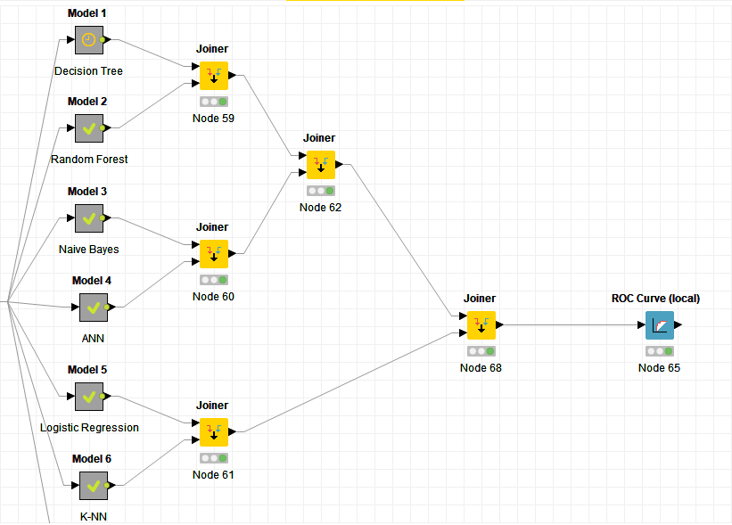
Approach to get to the Final ROC

Slide 32
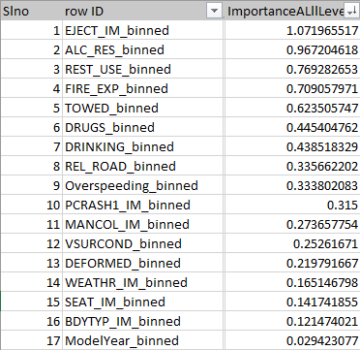
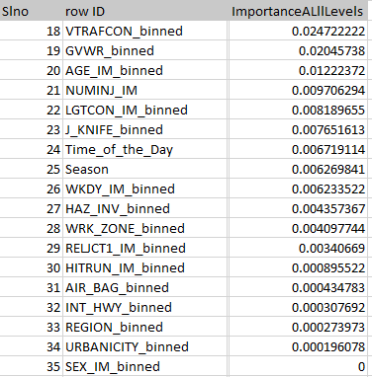
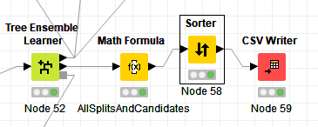
Level of importance of Predictors

Slide 33
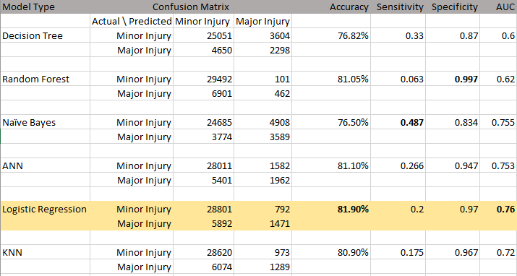
Evaluation

Slide 34
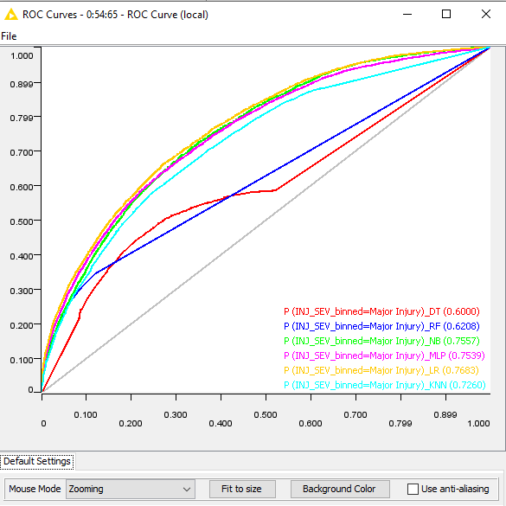
ROC Curves of the six models

Slide 35
Deployment
Could not be maintained in academic environment
In a larger business environment, models could be updated and adjusted for changes in cars, such as self driving cars and new components being used in for example electric cars and then deployed.

Slide 36
Conclusion
Our model identified restraint use, alcohol use and , if they were ejected as major factors as to the occurrence of crashes.
Clearly Ejection is generally tied to whether a restraint was used or not.
Government should continue to use programs to generate awareness around drinking and driving.
Should also continue to generate awareness to the risk of not using a restraint while driving.

Slide 37


Slide 38


